Slide 1
SBI Management System
By Jeff Jordan & Kevin Patel

Slide 2
Background
This software is a daily manager for a specific motel, a motel that is owned by the family of one of the project creators, the motel being called Stone Brook Inn, hence SBI.
This project is going to be used in the place of a daily record paper and pen record system that is currently being used in the motel.
The only essential things to know about using the software is that sides are not distinguished within the software as those running the program are expected to know what the sides are.

Slide 3
Approach
When creating the project, we basically started from the ground up learning C# on the fly, with a lot of assistance from Dr. Ericson and Google.
Nothing too special was used beyond implemented the background image which was just a rip of a free stock photo from Google.
In the design of the project, we used the Observer pattern in order to check and ensure rooms were up to date.

Slide 4
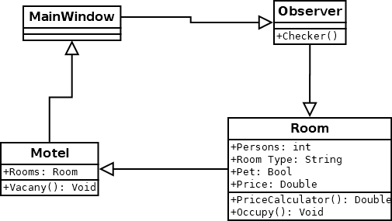
Diagrams

Slide 5
Demo

Slide 6
Future Work
We need to implement a database in order to make this software not just a daily helper and a full management system.
Along that line, also being able to integrate an API to pull reservations from websites such as Hotel.com/Trivago.com, etc.

Slide 7
Questions
kevjpate@ut.utm.edu
jefljord@ut.utm.edu
OurRepo: https://github.com/jefljord/Group-Deliverable

